Slide 1




Spring Cloud Config Server

Slide 2

Existing Challenges
Changes to services or environment variables require rebuild and redeploy.

Slide 3
Solution
Spring Cloud Config Server
Centralized, versioned configuration management for distributed applications

Slide 4


Environment Repository
Environment repository used by Spring Cloud Config has two implementations:
Git
spring.cloud.config.server.git.uri=file://D:/IntelliJProject/Git/springCloudConfigserver/git-localconfig-repo
Native (Local files)
spring.cloud.config.server.native.searchLocations=classpath:/

Slide 5
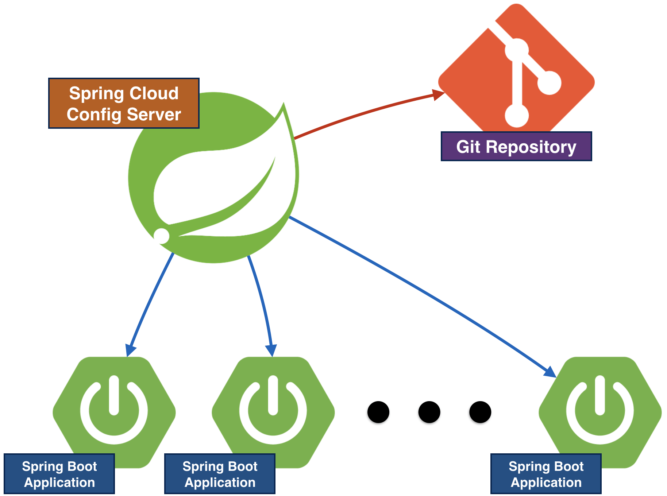

Slide 6
Organizing Environment Repository
Configuration file naming convention:
  <spring.application.name>-<profile>.yml
(or .properties)
.yml takes precedence
  spring.application.name set by client’s application
  bootstrap.yml (or .properties)
  Profile: client's spring.profiles.active
Obtain settings from server
  http://<server>:<port>/<spring.application.name>/<profile>

Slide 7
Environment Repository Example
Assume client application named “hello-world” and profile set to “dev”
Spring client automatically requests
hello-world-dev.yml - First precedence
hello-world-dev.properties - Second precedence
hello-world.yml - Third precedence
hello-world.properties - Fourth precedence
hello-world-default.yml - Different profile
hello-world-test.properties - Different profile
hi-world.properties - Different app

Slide 8
.yml vs .properties
Settings can be stored in either YAML or standard Java properties file.
Config Server will favor .yml over .properties
.properties file
spring.config.name=aaa
spring.config.location=bbb
spring.profiles.active=ccc
spring.profiles.include=ddd
.yml file
spring:
config:
name: aaa
location: bbb
profiles:
active: ccc
include: ddd

Slide 9

Profiles
YAML format can hold multiple profiles in a single file
hello-world-dev.properties
hello-world=Welcome DEV
hello-world.yml
spring:
profiles: dev
hello-world: Welcome DEV
spring:
profles: test
hello-world: Welcome TEST
hello-world-test.properties
hello-world=Welcome TEST

Slide 10

Pattern
The pattern format is a comma-separated list of {application}/{profile} names with wildcards
If {application}/{profile} does not match any of the patterns, it will use the default uri

Slide 11
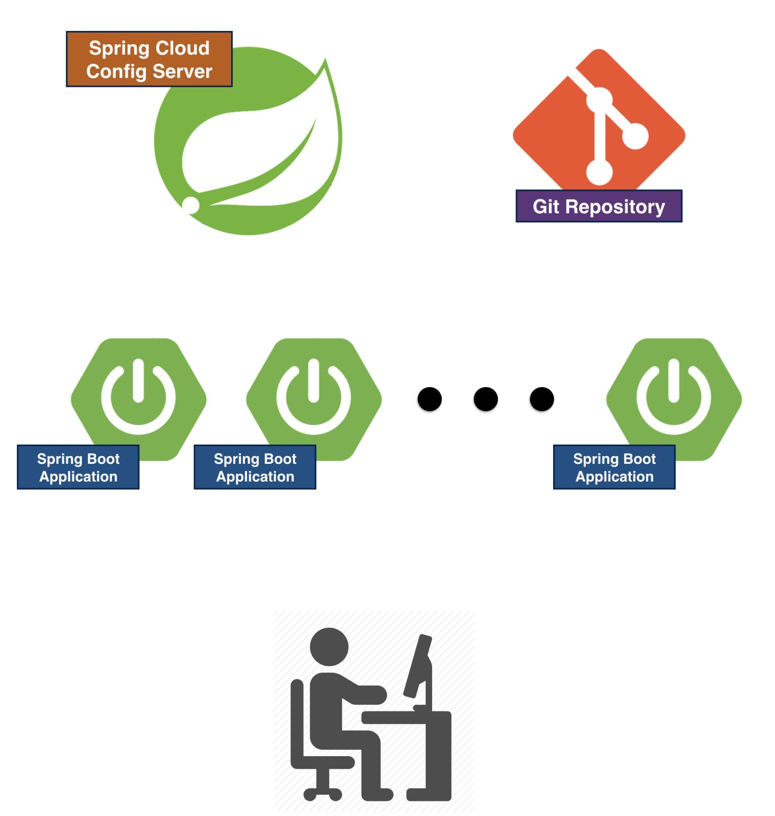
Refresh
Refresh
Refresh
Refresh

Slide 12

Refresh
Client application can have this property to enable refresh end point
management.endpoints.web.exposure.include=*
User has to trigger the refresh end point by hitting this url
http://localhost:8080/actuator/refresh

Slide 13
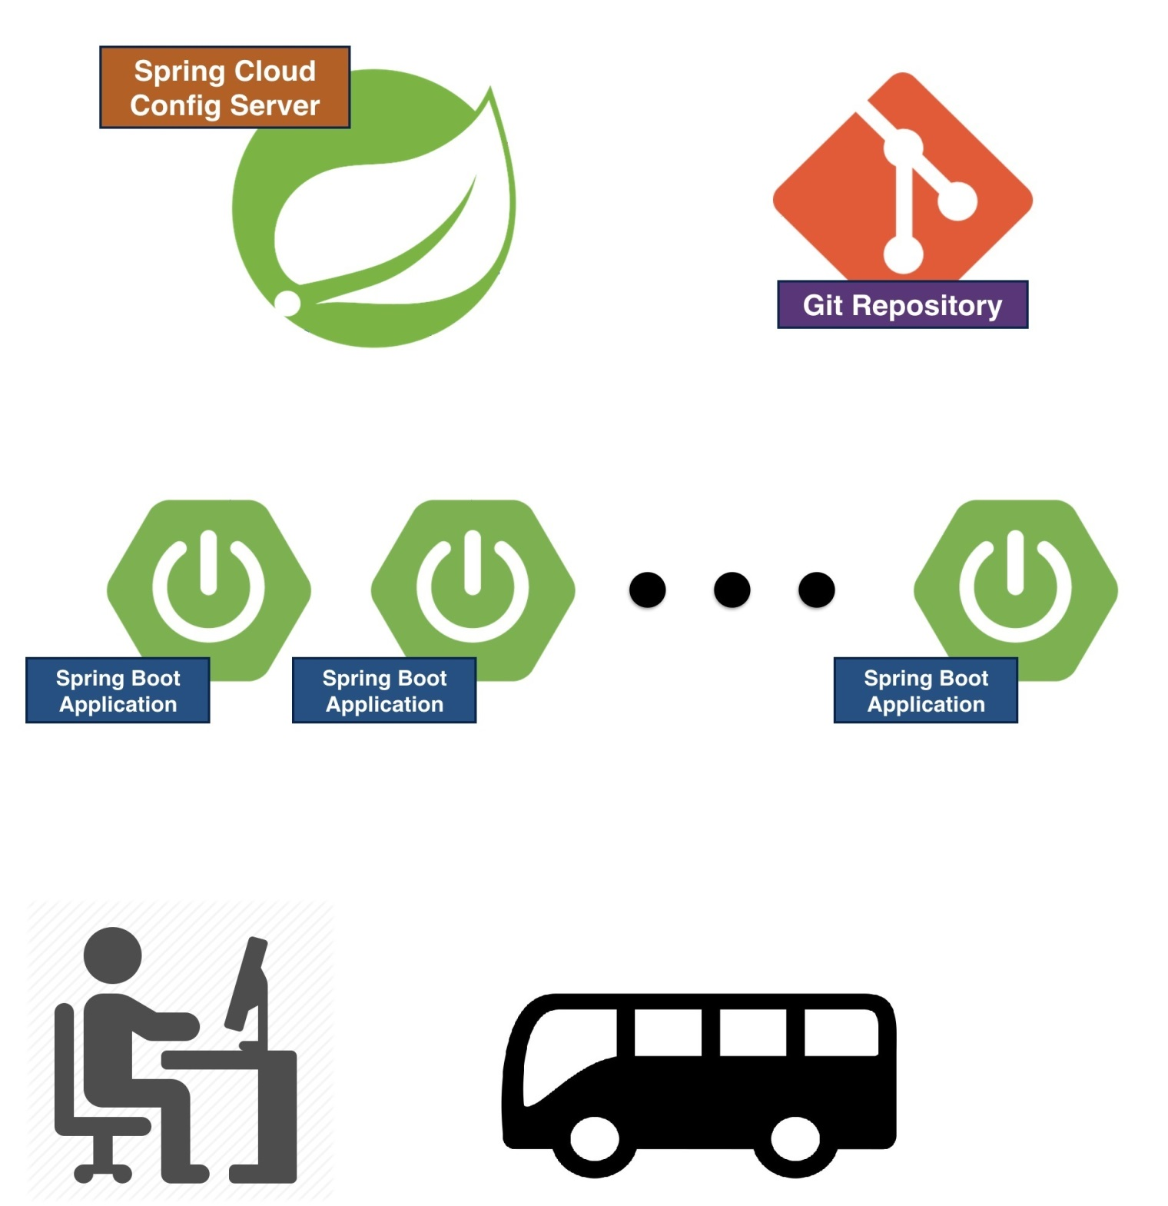
Spring Cloud BUS
BUS/Refresh
Refresh
Refresh
Cloud Bus

Slide 14

Spring Cloud Bus
Spring Cloud Bus links nodes of a distributed system with a lightweight message broker
User has to trigger the bus end point by hitting this url
http://localhost:8080/bus/refresh

Slide 15
What if Config Server is down?
Spring Cloud Config Server should typically run on several instances
So down time should be a non-issue
Client application can control policy of how to handle missing config server
spring.cloud.config.failFast = true (false by default)

Slide 16
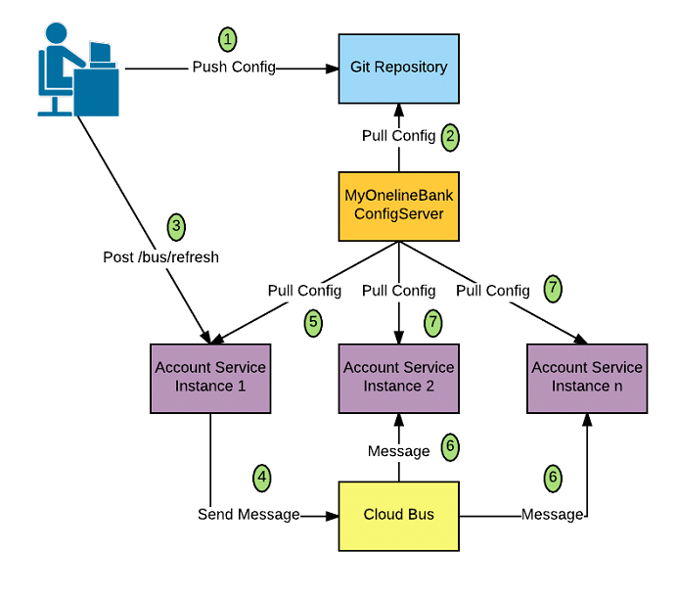

Slide 17

Thank You

